Slide 1
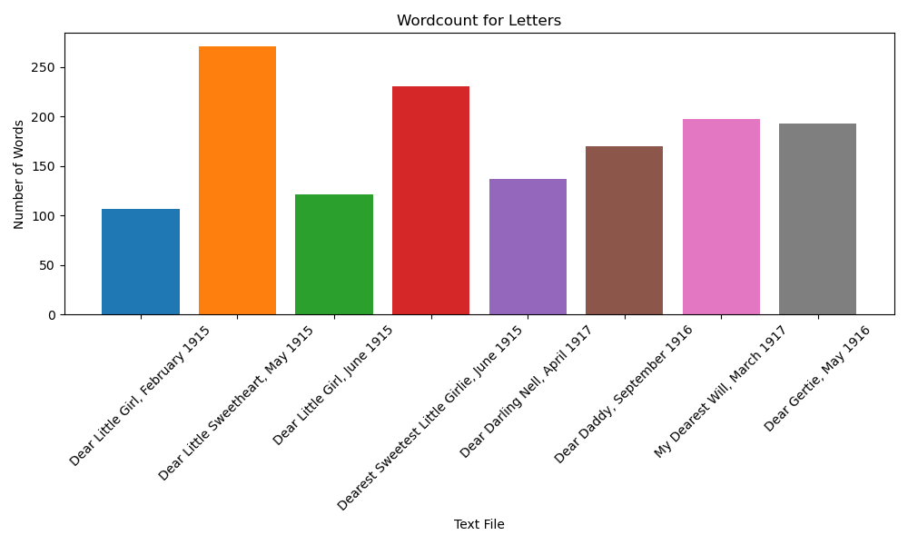
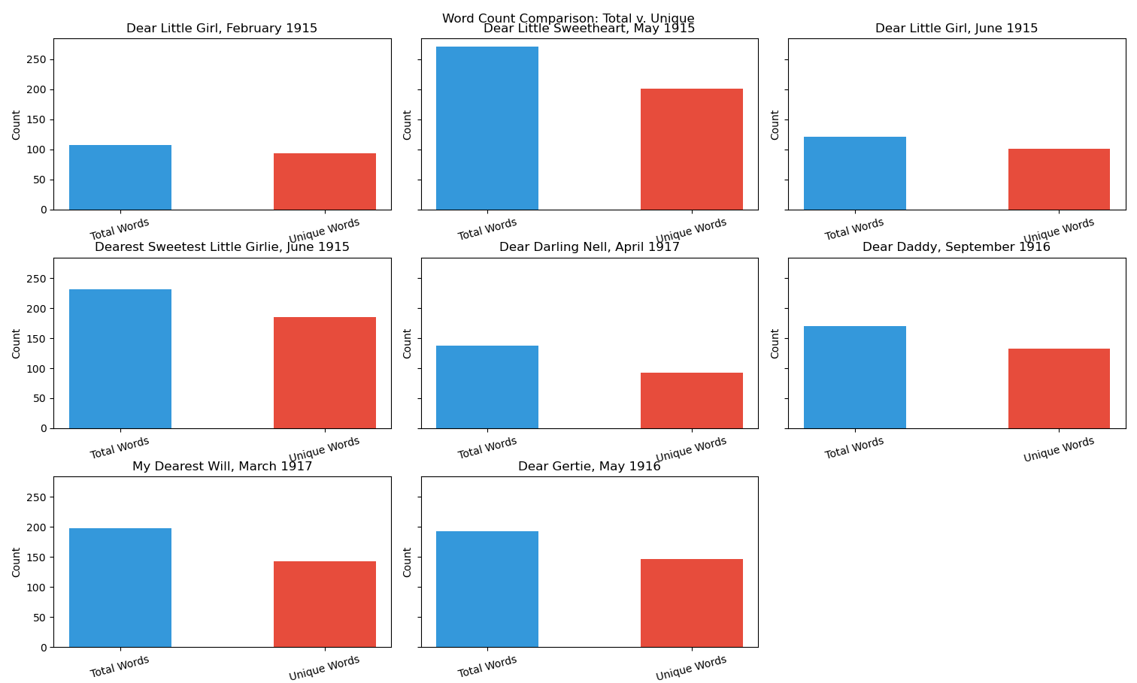
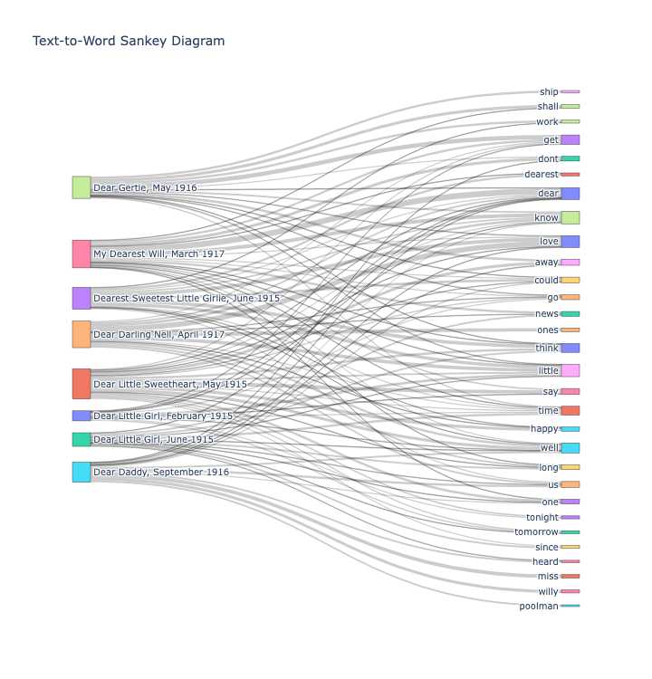
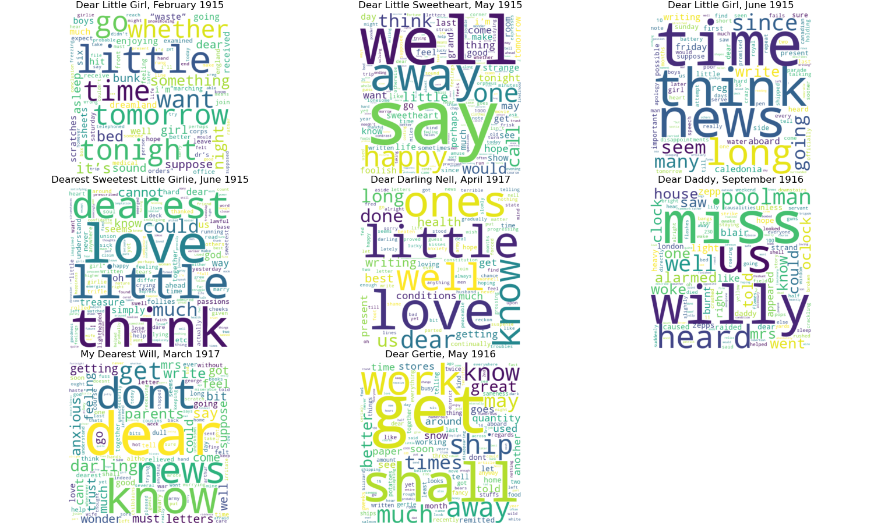
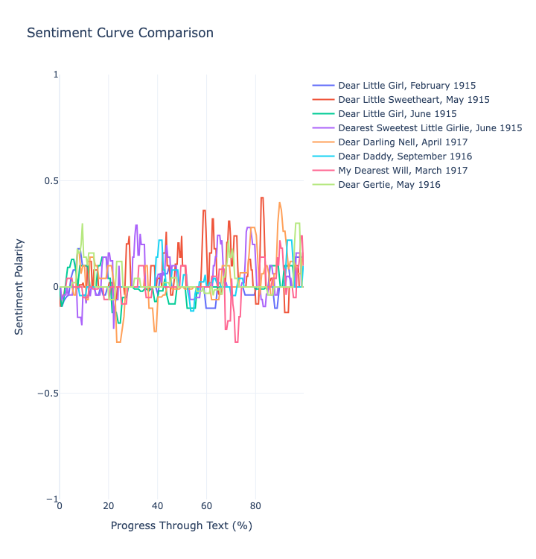
Do NOT change font or other elements of the top bar of the template here. Add only information from approved proposal.
Primary Mentor Name (only 1, from abstract, no titles or honorifics)
Subject category
Class
Group Number
Delete this box once complete.
Mentor Name. :
Subject/Category :
Class : Group # :
Project Title
Chipego, Emma, Lydia, Suraj
Remember:
We suggest quadrant format but you can use alternate forms.
The poster is a prop to engage people in conversation.
Use images/figures to spur conversation and make them easy to see at a distance.
Use text sparingly and make sure it is large enough to see. Use headers, bullet points, larger fonts.
Delete this box once complete.
You can add acknowledgements in body if you wish.
Do include detailed author contributions.
Delete this box once complete.

